Slide 1
CS 211 Computer Architecture Lecture 24 : Microarchitecture - Datapath Design – 1 Processor Components Sequential Logic Circuit, Registers, Clock
Ravi Mittal
ravi.mittal@iitgoa.ac.in
Indian Institute of Technology, Goa

Slide 2
In this lecture we will study
Microarchitecture – Top level view
Logic Circuits
Basics
Circuits that can store information
RS Latch
Gated D latch
The Clock
FSM

Slide 3
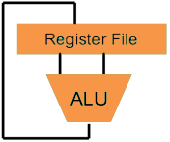
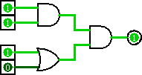
Overview
Higher-Level Language Program (e.g. C)
temp = v[k];
v[k] = v[k+1];
v[k+1] = temp;
Compiler
lw $t0, 0($2)
lw $t1, 4($2)
sw $t1, 0($2)
sw $t0, 4($2)
Assembly Language Program (e.g. RISC-V)
Assembler
0000 1001 1100 0110 1010 1111 0101 1000
1010 1111 0101 1000 0000 1001 1100 0110
1100 0110 1010 1111 0101 1000 0000 1001
0101 1000 0000 1001 1100 0110 1010 1111
Machine Language Program (RISC-V)
We are here
Machine Interpretation
Hardware Architecture Description (e.g. block diagrams)
Architecture Implementation
Logic Circuit Description (Circuit Schematic Diagrams)
Prof Krste Asanović & Randy H. Katz, Univ of California, Berkeley

Slide 4
Why is this important to study Hardware Design?
Computer scientists should have an answer to the question “How does a computer work?”
So you can understand how code is actually executed on a computer
Why do we care about how code executes?
Reliability
Performance
Security
Prof Krste Asanović & Randy H. Katz, Univ of California, Berkeley

Slide 5
Hardware Design
Example of the power of layered abstractions
Transistors -> Combinational Logic
Combinational Logic -> Sequential Logic
Sequential Logic -> Processors
Processors -> Machine Language
Machine Language -> Assembly
Assembly -> High-level Programming Languages
High-level Programming Languages -> Word, Facebook, Twitter
At each step we can “abstract away” the lower steps and (mostly) forget they exist

Slide 6
Hardware Design
Transistors
Combinational Logic
Sequential Logic
Processors
Machine Language
Assembly
High-level Programming Languages
Covered in Digital Logic Course
We will briefly discuss these today
Next 12 lectures
Covered in lectures so far

Slide 7
Microarchitecture
Defines the specific arrangement of
Registers
ALU
FSM
Memories
Other logic building blocks
RISC-V architectures - can be designed in many ways – based on requirements of
Performance
Cost
Complexity
Let’s go bottom up when discussing Microarchitecture
Logic Circuits, Components, Datapath, Control logic

Slide 8
Logic Circuits Basics

Slide 9
Synchronous Digital Systems (SDS)
Hardware of a processor, such as a RISC-V processor, is an example of a Synchronous Digital System
Synchronous:
All operations coordinated by a central clock
“Heartbeat” of the system! (processor frequency)

Slide 10
Types of Logic Circuits
Synchronous Digital Systems consist of two basic types of circuits:
Combinational Logic (CL) circuits
Output is a function of the inputs only, not the history of its execution
E.g., circuits to add A, B (ALUs)
Sequential Logic (SL)
Circuits that “remember” or store information
State Elements
E.g., memories and registers (Registers)

Slide 11
Circuits that can store Information

Slide 12
Sequential Circuits: Introduction
Combinational circuit output depends only on current input
We want circuits that produce output depending on current and past input values – circuits with memory
Sequential Circuit gives sequence to events; Use feedback
Sequential Circuit
inputs
Combinational
Circuit
outputs
Storage
Element
From Prof Onur Mutlu’s presentation

Slide 13
State Elements
State of the system
Sequential logic might explicitly remember certain previous inputs, or it might distil the prior inputs into a smaller amount of information called the state of the system
The state of a digital sequential circuit is a set of bits called state variables that contain all the information about the past necessary to explain the future behaviour of the circuit
The state of a circuit influences its future behavior
State elements store state
Bistable circuit
RS Latch
D Latch
D Flip-flop
State Elements used in a
Processor:
Registers, PC, Memory

Slide 14
Uses of State Elements
Place to store values for later use:
Register files (like x0-x31 on the RISC-V)
Memory (caches and main memory)
Help control flow of information between combinational logic blocks
State elements hold up the movement of information at input to combinational logic blocks to allow for orderly passage

Slide 15
Basic Storage Element The RS Latch

Slide 16
The RS (Reset-Set) Latch
The simplest implementation of the R-S Latch
Two NAND gates with outputs feeding into each other’s input
Data is stored at Q (inverse at Q’)
S and R inputs are held at 1 then Q =Q_{prev} Memory!
S (set): drive S to 0 (keeping R at 1) to change Q to 1
R (reset): drive R to 0 (keeping S at 1) to change Q to 0
S and R should never both be 0 at the same time
S
Q
Input |  | Output
R | S | Q
1 | 1 | Q_{prev}
1 | 0 | 1
0 | 1 | 0
0 | 0 | Invalid
R
Q’
From Prof Onur Mutlu’s presentation

Slide 17
Why not R=S=0?
1
0
S
Q
Input |  | Output
R | S | Q
1 | 1 | Q_{prev}
1 | 0 | 1
0 | 1 | 0
0 | 0 | Invalid
1
0
1
0
R
0
Q’
1
If R=S=0, Q and Q’ will both settle to 1, which breaks our invariant that Q = !Q’
If S and R transition back to 1 at the same time, Q and Q’ begin to oscillate between 1 and 0 because their final values depend on each other (metastability)
From Prof Onur Mutlu’s presentation

Slide 18
The Gated D Latch

Slide 19
The Gated D Latch
How do we guarantee correct operation of an RS Latch?
S
Q
Q’
R
From Prof Onur Mutlu’s presentation

Slide 20
The Gated D Latch
How do we guarantee correct operation of an R-S Latch?
Add two more NAND gates!
Q takes the value of D, when write enable (WE) is set to 1
S and R can never be 0 at the same time!
D
S
Q
Write
Enable
Q’
R
From Prof Onur Mutlu’s presentation

Slide 21
The Gated D Latch
D
S
Q
Write
Enable
R
Q’
Input |  | Output
WE | D | Q
0 | 0 | Q_{prev}
0 | 1 | Q_{prev}
1 | 0 | 0
1 | 1 | 1
Note that the circuit is un-clocked
From Prof Onur Mutlu’s presentation

Slide 22
The Clock

Slide 23
The Clock
A microprocessor is composed of many different circuits that are operating simultaneously – if each circuit X takes in inputs at time TI_{X}, takes time TE_{X} to execute the logic, and produces outputs at time TO_{X}, imagine the complications in co-ordinating the tasks of every circuit
All circuits on the chip share a clock signal (a square wave) that tells every circuit when to accept inputs, how much time they have to execute the logic, and when they must produce outputs

Slide 24
Clock Terminology
Rising clock edge
Cycle time
Falling clock edge
4 GHz = clock speed = 1 = 1 .
cycle time 250 ps

Slide 25
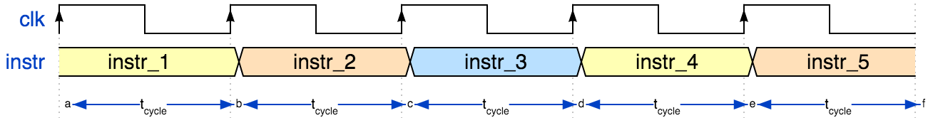
The Clock
f_{s} = 1/ t_{cycle}
Clock frequency f_{s} | Period t_{cycle} = 1/f_{s}
CPU 2.5 GHz | 400 ps
Drum/heartbeat, 1Hz | 1 s
Prof Krste Asanović & Randy H. Katz, Univ of California, Berkeley
Notes:
Faster processors enabled
digital audio ~ 1980
digital video 199x
… now enables entirely new functions (e.g. search engines) that did not even exist with analog processing.
But: many physical signals are inherently analog. E.g. my voice: I cannot speak ”digital”, and you could not understand me anyway.
{signal: [ {name: 'clk', wave: 'P....'}, {name: 'instr', wave: '34534', data: 'instr_1 instr_2 instr_3 instr_4 instr_5'}, {node: 'abcdef'}], edge: ['a<->b t<sub>cycle', 'c<->b t<sub>cycle', 'c<->d t<sub>cycle', 'd<->e t<sub>cycle', 'e<->f t<sub>cycle', ], config: { hscale: 3 }}

Slide 26
Changing State: The Notion of Clock (I)
We need a clock to dictate when to change state
Clock signal alternates between 0 & 1
At the start of a clock cycle ( ), system state changes
During a clock cycle, the state stays constant
Edge-triggered clocking: all state changes occur on a clock edge
In an edge-triggered methodology, either the rising edge or the falling edge of the clock is active and causes state changes to occur
1
CLK:
0
Prof Krste Asanović & Randy H. Katz, Univ of California, Berkeley

Slide 27
Changing State: The Notion of Clock (II)
Clock is a general mechanism that triggers transition from one state to another in a sequential circuit
Clock synchronizes state changes across many sequential circuit elements
Combinational logic evaluates for the length of the clock cycle
Clock cycle should be chosen to accommodate maximum combinational circuit delay
The clock edge acts as a sampling signal, causing the value of the data input to a state element to be sampled and stored in the state element
The sampling process is essentially instantaneous
eliminates problems that could occur if signals were sampled at slightly different times

Slide 28
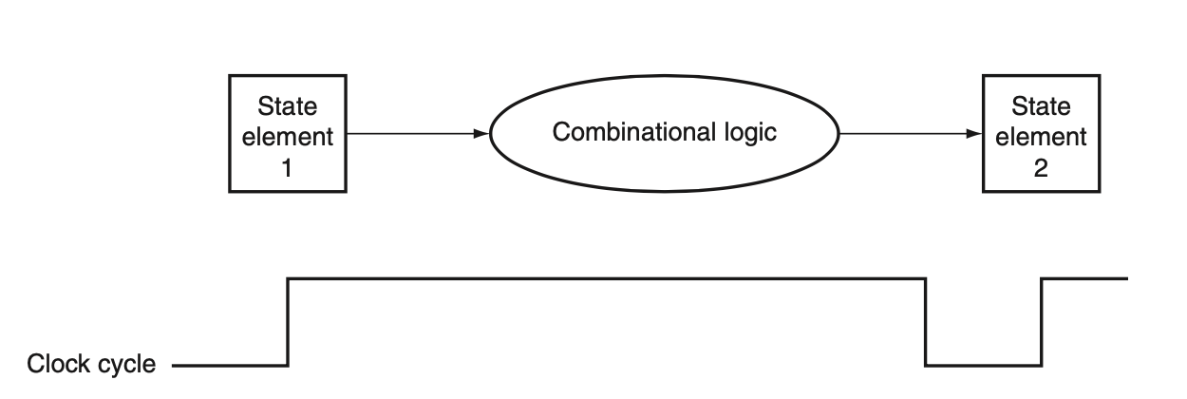
Relationship between state elements and combinational logic
The signals that are written into state elements must be valid when the active clock edge occurs
State element’s output changes after clock’s active edge
Provides valid inputs to combinational logic block
Clock must have a long enough period so that all the signals in the combinational logic block stabilize
The clock edge samples those values for storage in the state elements
In this course (CS211), we consider rising edge triggered state changes
Notes:
The write signal must still be gated with the clock so that the update occurs only on the clock edge if the write signal is active.

Slide 29
Finite State Machines

Slide 30
Finite State Machines
What is a Finite State Machine (FSM)?
A discrete-time model of a stateful system
Each state represents a snapshot of the system at a given time
An FSM pictorially shows
1. the set of all possible states that a system can be in
2. how the system transitions from one state to another
An FSM can model
A traffic light, an elevator, fan speed, a microprocessor, etc.
An FSM enables us to pictorially think of a stateful system using simple diagrams

Slide 31
Finite State Machines (FSMs)
FSM consists of Five elements:
A finite number of states
State: snapshot of all relevant elements of the system at the time of the snapshot
A finite number of external inputs
A finite number of external outputs
An explicit specification of all state transitions
How to get from one state to another
An explicit specification of what determines each external output value
From Prof Onur Mutlu’s presentation

Slide 32
Finite State Machines (FSMs)
Each FSM consists of three separate parts:
next state logic
state register
output logic
state register
At the beginning of the clock cycle, next state is latched into the state register
From Prof Onur Mutlu’s presentation

Slide 33
Finite State Machines (FSMs) Consist of:
Sequential circuits
State register(s)
Store the current state and
Load the next state at the clock edge
Combinational Circuits
Next state logic
Determines what the next state will be
Output logic
Generates the outputs
From Prof Onur Mutlu’s presentation
Notes:
discuss DFlipFlop here. Latch doesn't do this, so we need sequential circuit that stores state and loads next state at the clock edge. next state is available for the full clock cycle
now lets take a look at this.

Slide 34
State Register Implementation with D type Flipflop

Slide 35
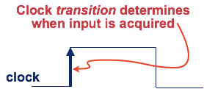
State Register Implementation
How can we implement a state register? Two properties:
1. We need to store data at the beginning of every clock cycle
2. The data must be available during the entire clock cycle
1
CLK:
0
Register
Input:
Register
Output:
Desired behavior
Notes:
Introduce clock much earlier maybe.
input data is sampled once.

Slide 36
The Problem with Latches
Recall the
Gated D Latch
D
Q
CLK = WE
Currently, we cannot simply wire a clock to WE of a latch
Whenever the clock is high, the latch propagates D to Q
The latch is transparent
1
CLK:
0
Register
Input:
Register
Output:
From Prof Onur Mutlu’s presentation

Slide 37
The Problem with Latches
Recall the
Gated D Latch
D
Q
CLK = WE
Currently, we cannot simply wire a clock to WE of a latch
Whenever the clock is high, the latch propagates D to Q
The latch is transparent
1
CLK:
0
Register
Input:
Register
Output:
Undesirable!
From Prof Onur Mutlu’s presentation

Slide 38
The Problem with Latches
Recall the
Gated D Latch
D
Q
CLK = WE
Currently, we cannot simply wire a clock to WE of a latch
When the clock is high Q will not take on D’s value AND
When the clock is low the latch will propagate D to Q
How can we change the latch, so that
1) D (input) is observable at Q (output)
only at the beginning of next clock cycle?
2) Q is available for the full clock cycle
1
CLK:
0
Input:
Output:

Slide 39
The Need for a New Storage Element
To design viable FSMs
We need storage elements that allow us
to read the current state throughout the current clock cycle
AND
not write the next state values into the storage elements until the beginning of the next clock cycle.
From Prof Onur Mutlu’s presentation

Slide 40
The D Flip-Flop
1) state change on clock edge, 2) data available for full cycle
D Latch (Master)
D
D Latch (Slave)
Q
CLK
1
CLK:
0
When the clock is low, master propagates D to the input of slave (Q unchanged)
Only when the clock is high, slave latches D (Q stores D)
At the rising edge of clock (clock going from 0->1), Q gets assigned D

Slide 41
The D Flip-Flop
1) state change on clock edge, 2) data available for full cycle
D
Q
CLK
__
Q
D Flip-Flop
1
CLK:
0
At the rising edge of clock (clock going from 0->1), Q gets assigned D
At all other times, Q is unchanged
From Prof Onur Mutlu’s presentation

Slide 42
The D Flip-Flop
How do we implement this?
D
Q
CLK
We can use these Flip-Flops
to implement the state register!
__
Q
D Flip-Flop
1
CLK:
0
At the rising edge of clock (clock going from 0->1), Q gets assigned D
At all other times, Q is unchanged

Slide 43
Rising-Clock-Edge Triggered Flip-Flop
Two inputs: CLK, D
Function
The flip-flop “samples” D on the rising edge of CLK (positive edge)
When CLK rises from 0 to 1, D passes through to Q
Otherwise, Q holds its previous value
Q changes only on the rising edge of CLK
A flip-flop is called an edge-triggered state element because it captures data on the clock edge
Note that a latch is a level-triggered state element
CLK
RS latch operates on input levels
D FF operates on (clock) edges
From Prof Onur Mutlu’s presentation

Slide 44
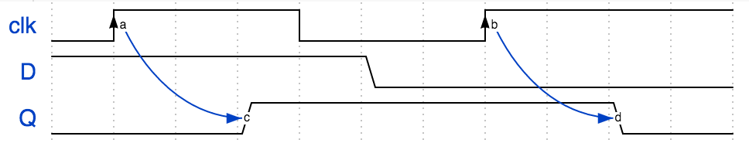
(Positive) Edge Triggered Flip-Flop
D
Q
CLK
Clock “CLK”
Time
Notes:
{signal: [ {name: 'clk', wave: '0H..l..H...', node: '.a.....b'}, {name: 'D', wave: '1....0.....'}, {name: 'Q', wave: '0..1.....0.', node: '...c.....d'},], edge: [ 'a~->c', 'b~->d',]}

Slide 45
Register
Multiple parallel flip-flops, each of which storing 1 bit
Condensed
This line represents 4 wires
This register stores 4 bits
From Prof Onur Mutlu’s presentation

Slide 46
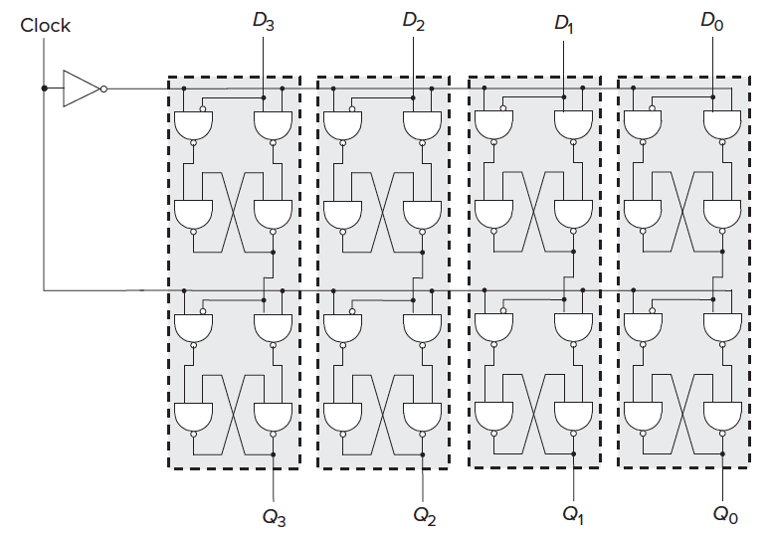
A 4-Bit D-Flip-Flop-Based Register (Internally)
Image source: Patt and Patel, “Introduction to Computing Systems”, 3rd ed., tentative page 95.

Slide 47
Class Summary
Processor design requires design of FSM
FSM consists of Sequential logic Circuits that can store state of the system
We have looked at functioning of
RS latch
Gated D latch
Problems of unstable output with Gated D latch
Use of clock – Edge triggering concept
The D Flipflop
They are the basic component of register file

